Slide 1
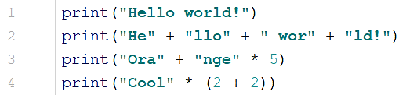
Starter 1: Basics
Use Python to work out what these will print to screen.
Write code to display your name five times with one print statement.
Write code to display ‘BANANA’ by typing ‘AN’ only once.

Slide 2

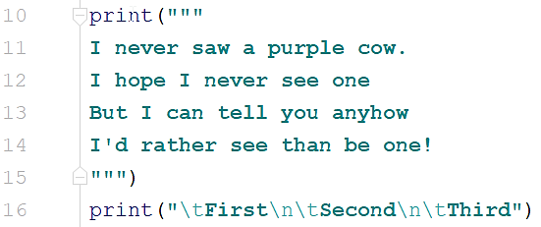
Starter 2: Basics
This makes the value ‘x’
into a string so it is a
word not a number.
Change the code so the printed answer is correct.
When printing strings we can use special characters. What will be the result of running this code?
What do \n
and \t do?

Slide 3



Starter 3: Basics
What will happen if I run this code?
What data type is shown here?
What is the result of running this code?
What does the operation on line 15 do?

Slide 4
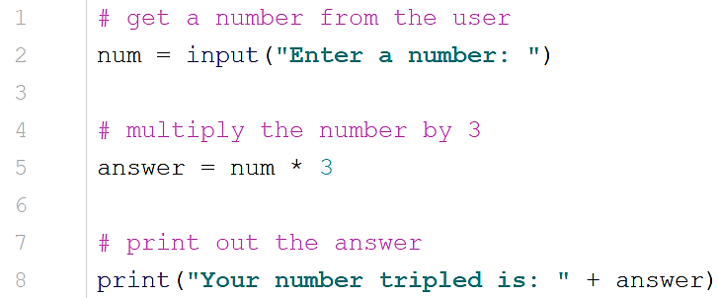
Starter 4
What will be the result of running this code and entering 5?
Make the changes required to make the code work.

Slide 5
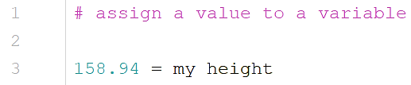
Starter 5
I want to assign the value 158.94 to represent how tall I am in centimetres. Is this correct?
Explain your answer and make any corrections needed.
What data type should I use to represent my height in my program?

Slide 6
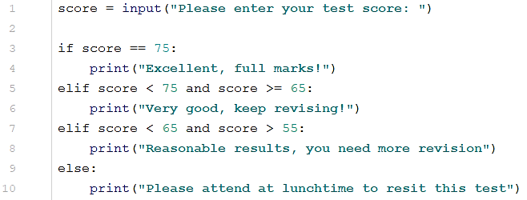
Starter 6
What will be the result of running this code and entering 52?

Slide 7
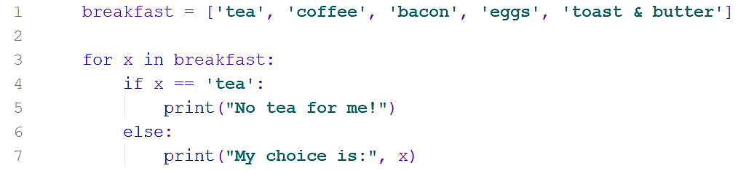
Starter 7
I do not like tea or bacon for breakfast. How can I edit the code ( without deleting any breakfast items) to print out my choices AND tell the restaurant staff the items I do not like?

Slide 8
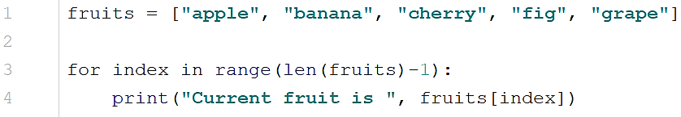
Starter 8
What will be printed to screen when the code is run?

Slide 9


Starter 9
This is the result of running this code:
Amend the code to get this result:
  -15, -10, -5, 0, 5

Slide 10
Starter 10
I want to write a function called days_in_month which calculates the days in a given month.
How do I start this in Python?
What should I add before I start writing the actual code?

Slide 11
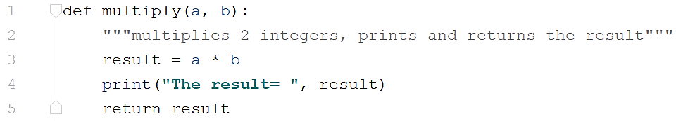
Starter 11
Call this function with the arguments 5 and 4.
What will happen if I change the arguments to ‘Woo’ and 5?
What will happen if I change the arguments to ‘Woo’ and ‘Hoo’?

Slide 12
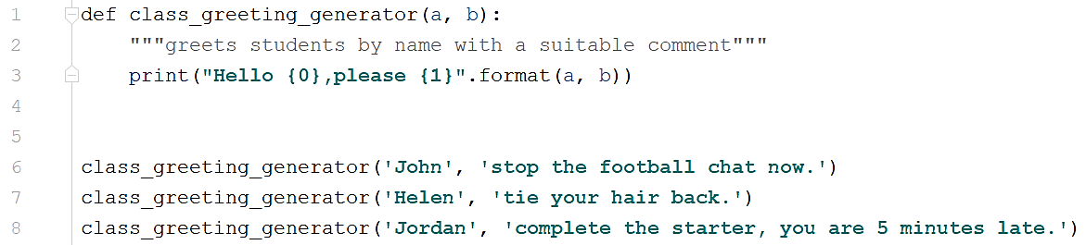
Starter 12
What is the difference between a parameter and an argument?
Label the code to show which is which.

Slide 13
Starter 13
True or False?
  7 == 9
  8 != 9
  5 > 4
  6 <= 7
  (8 > 8) == True
  (7 + 5) != 12
  a = False b = True , (5 < 7) == b
  (3 + 5 > 2 + 6) == False

Slide 14
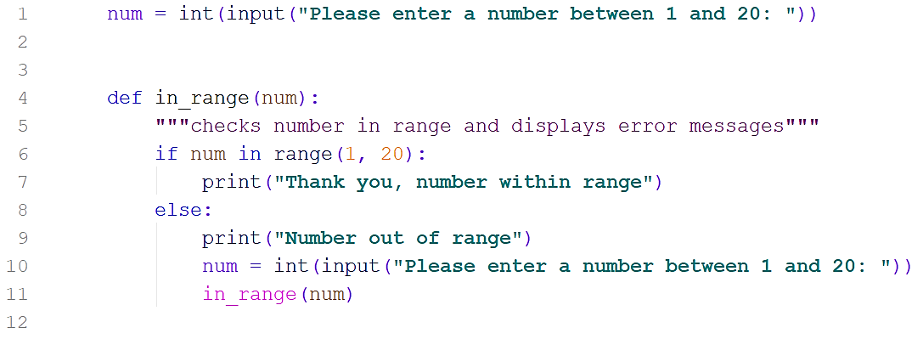
Starter 14
Draw a flow chart to represent this code.

Slide 15
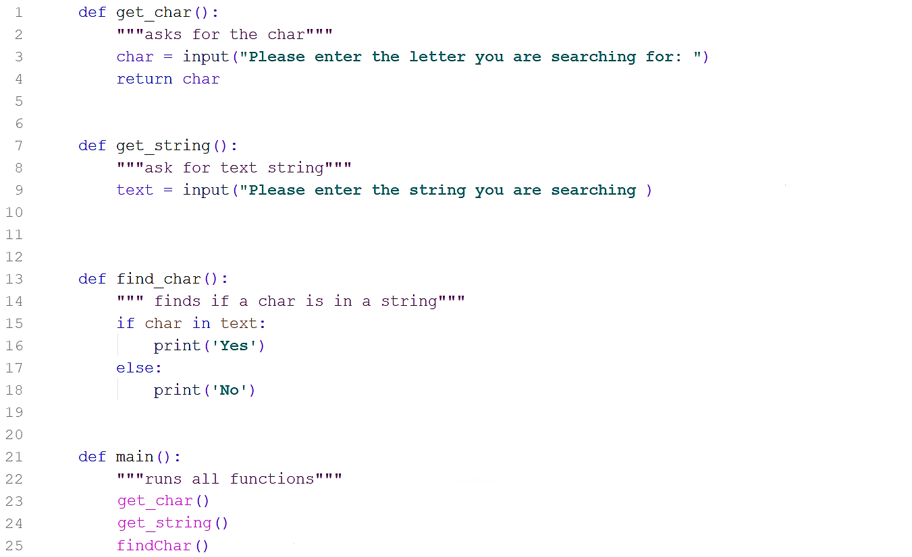
Starter 15
This code contains errors.
Identify the line numbers and explain the errors.

Slide 16
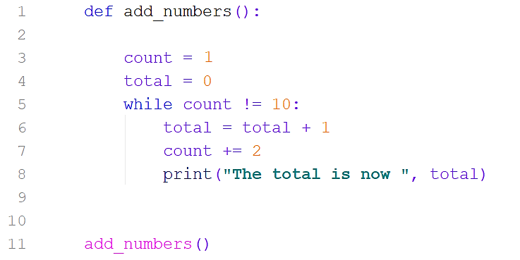
Starter 16
Explain what happens to the two variables, count and total, when the code is executed.
What corrections are needed for it to work correctly?

Slide 17
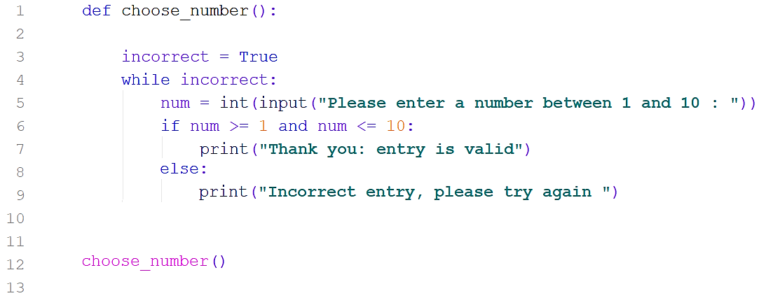
Starter 17
Look at the code. This does not work correctly at the moment.
Explain what corrections need to be made.

Slide 18
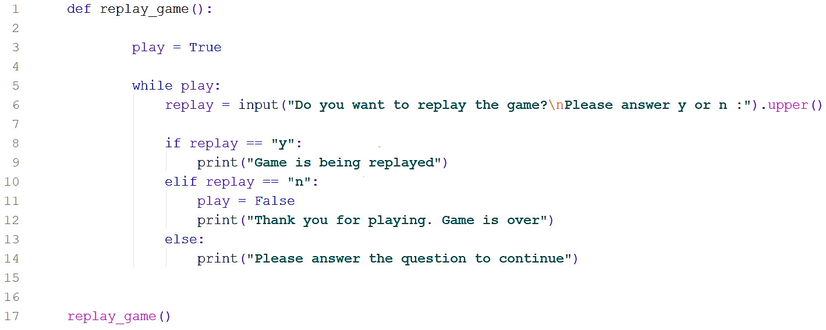
Starter 18
This code does not work correctly. There are two ways in which it could be corrected.

Slide 19
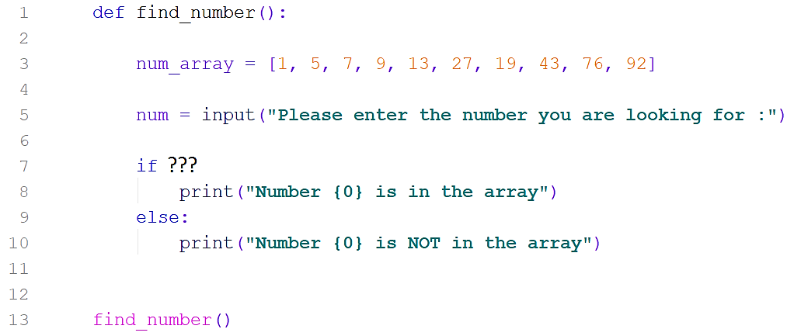
Starter 19
Complete the code so that it will check whether the number entered is in the array.
There are other errors in the code. Correct them.

Slide 20
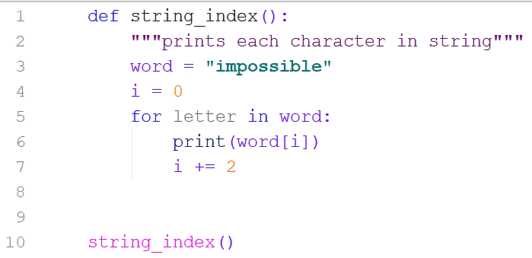
Starter 20
Explain what happens when this code is executed.
Can you explain why?
Edit the code to print all letters.

Slide 21
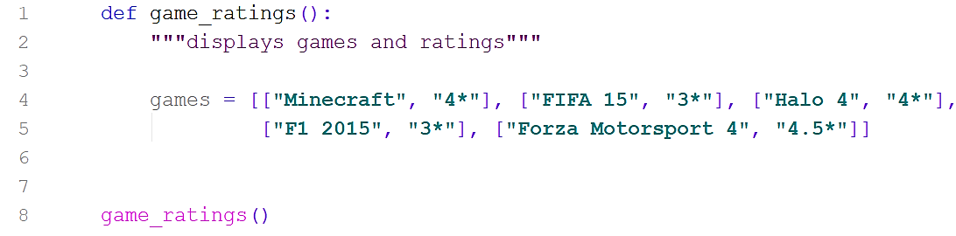
Starter 21
Edit the code below so that you can add the following details to the list:
Need for Speed-The Run, 4*
Now print out each game and rating on a new row.

Slide 22
Starter 22
Study the code on the next slide carefully. (code #1)
Look at what is happening when the code is executed. (execute code)
Why is the function asking me for more than three choices?
What changes do I need to make to the code to correct it? ( write on the sheet)
Can you explain in technical terms why this error is happening? (see next slide)

Slide 23
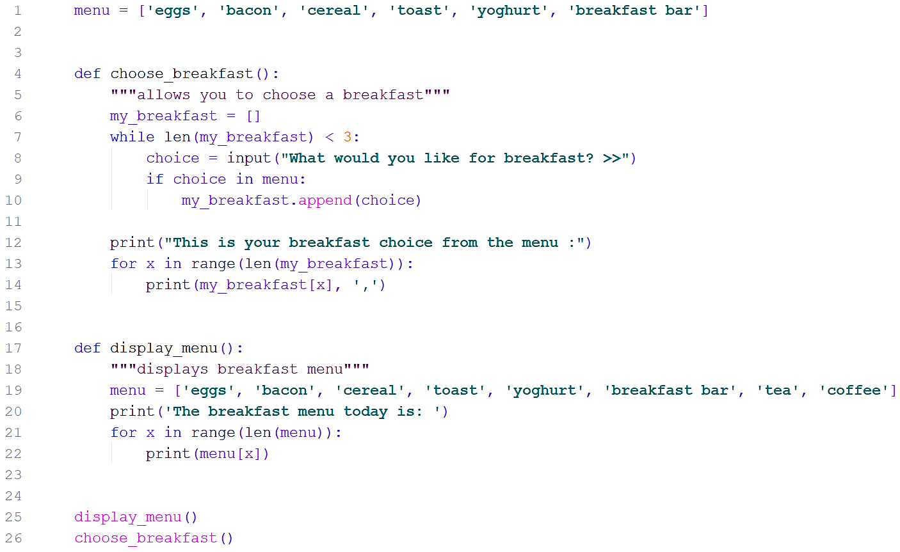
Starter 22 (code #1)

Slide 24
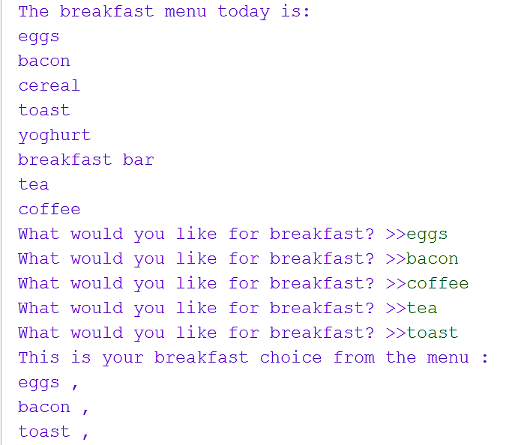
Starter 22 (execute code)

Slide 25
Starter 23
Open Notepad or other text editor and write a list of the following five items and save it:
tablet, smartphone, laptop, charger, portable drive
Write a function to read the file into an array.
Starting with tablet, print the odd items in the array.

Slide 26
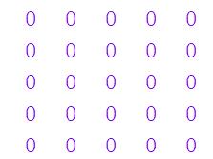
Starter 24
Lists in Python are also known as arrays.
Arrays can be two-dimensional like
the one shown on the right.
Write the function to create this
two-dimensional array of ‘0’s
(measuring 5 rows by 5 columns). Make sure you use the most efficient method of doing this.
Write the function to print out the 2D array in this format.

